Slide 1

FCI E-Campus The Way to Better Education

Slide 2
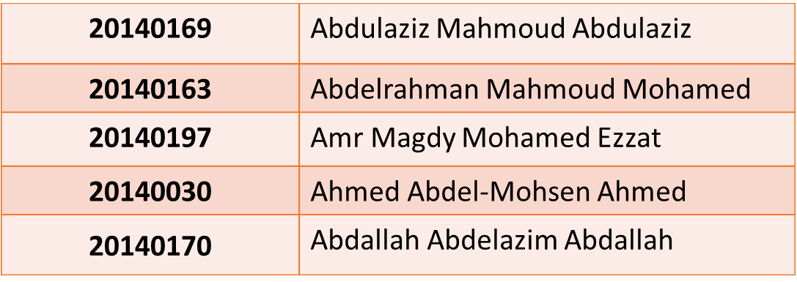
Supervised by
Dr. Mohammed Nassef
TA. Nora Abdelhamid
Implemented by

Slide 3

New student problems
Where are my materials?!
Where can I ask questions?!
Where can I find my courses’ tasks?!
What is my schedule ?!
Where are my labs’ & lectures’ halls?!

Slide 4




Old solutions
Your materials, tasks
and your questions on
FCI E-Com

Slide 5



Our solution
FCI E-Com

Slide 6
System Analysis and Design: Stakeholders
Students at FCI.
FCI professors, TAs & administration.

Slide 7
Functional requirements
For Student.
For TA and Professor.
For Admin.
✓ Future work.

Slide 8
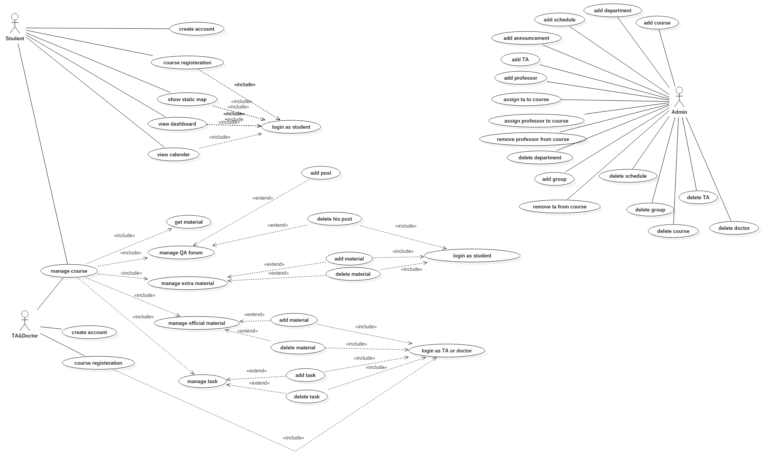
Use case diagram

Slide 9
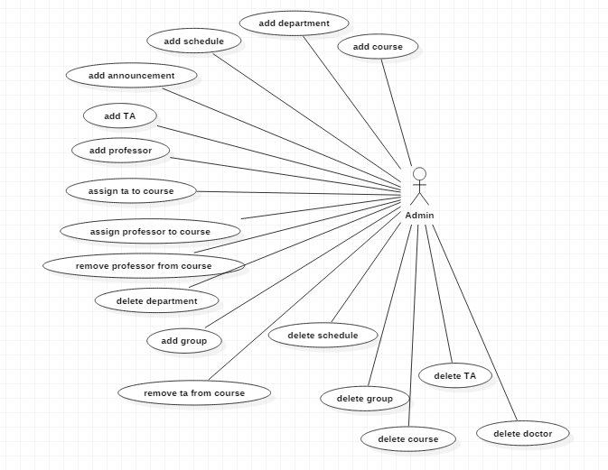
Admin use cases

Slide 10
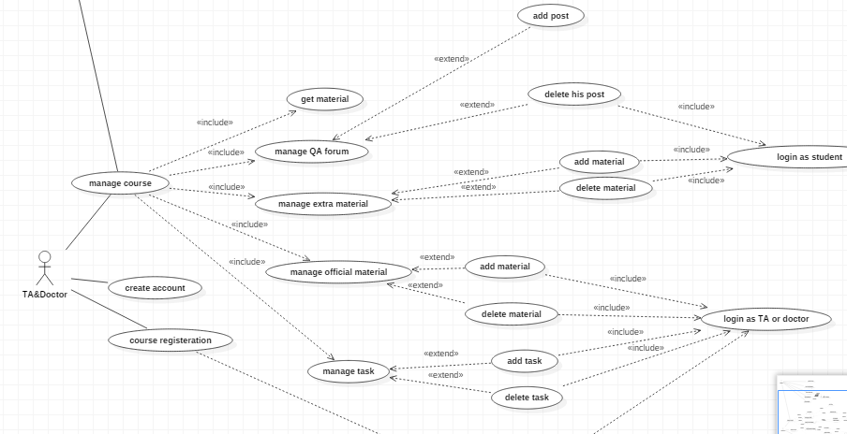
Student, TA and Professor use cases

Slide 11
System Analysis and Design: System architecture
Our system uses Service-Oriented Architecture (SOA).
RESTful Web Services provided by the backend consumed by the front-end clients.
Admin system uses Model-View-Controller (MVC).

Slide 12
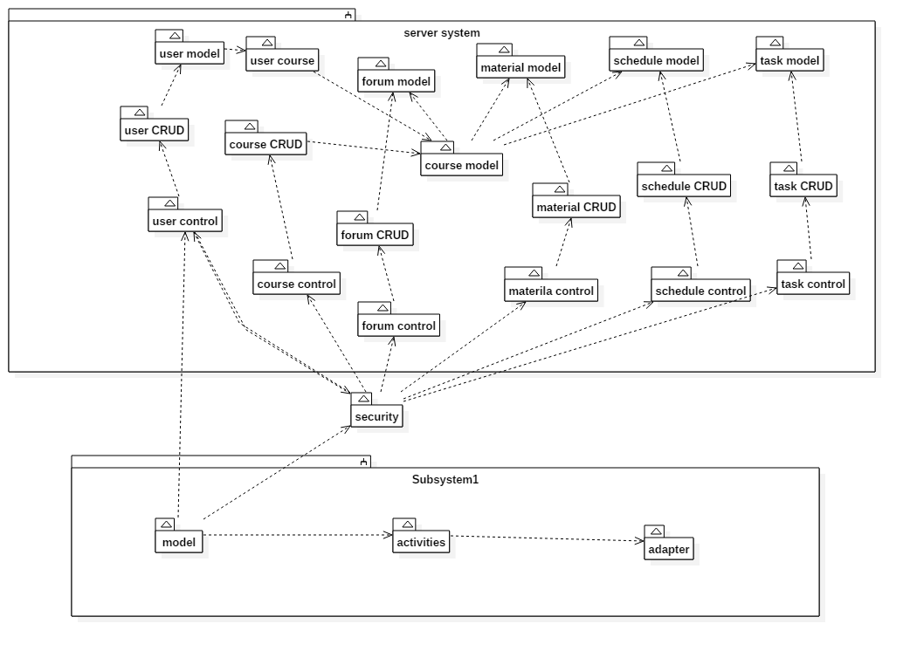
Component Diagram

Slide 13
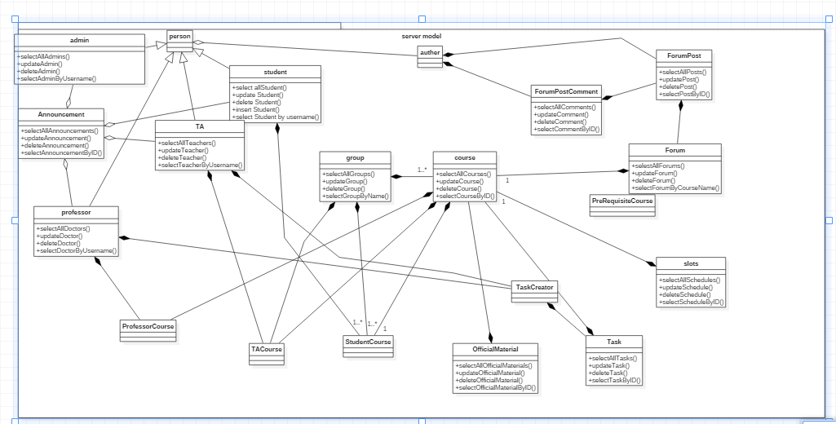
Model Class Diagram

Slide 14
Sequence Diagrams

Slide 15
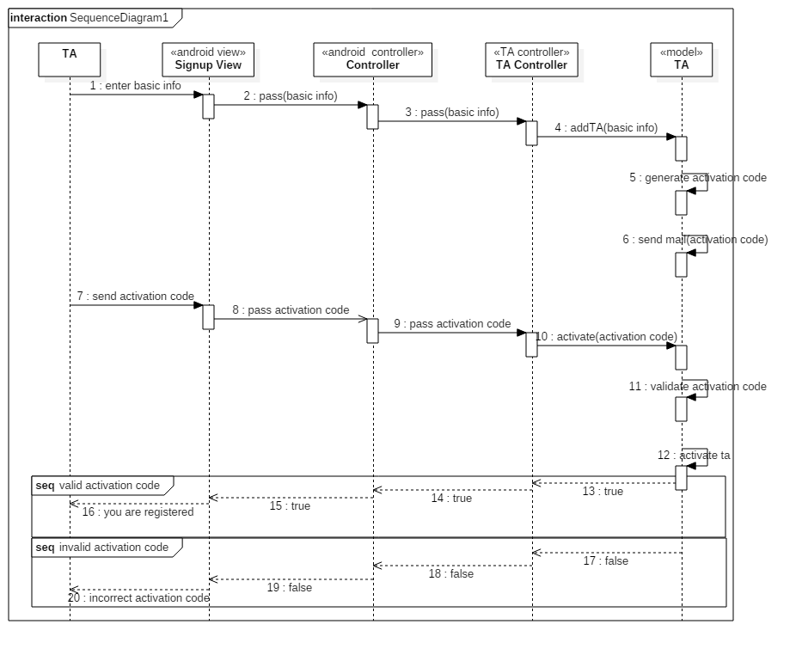
1. TA sign up

Slide 16
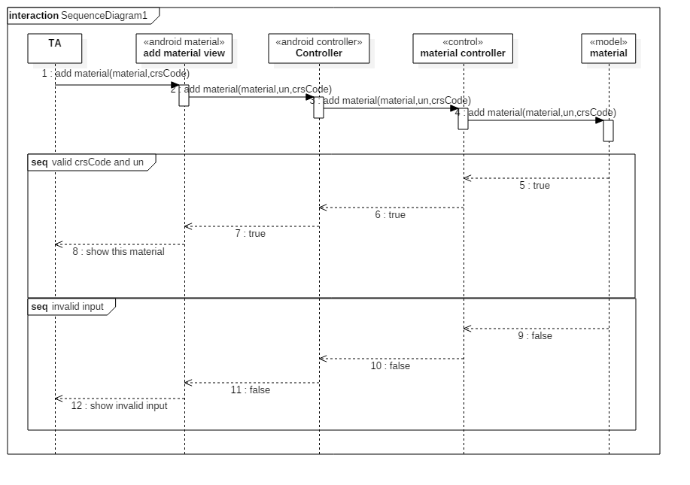
2. Add material

Slide 17
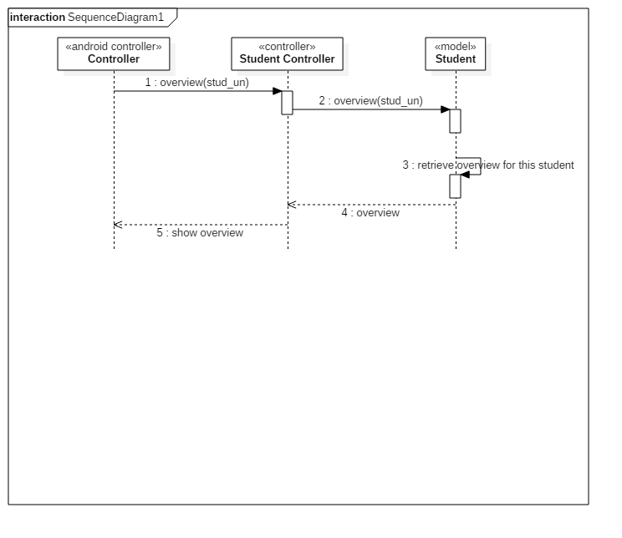
3. Student Overview

Slide 18
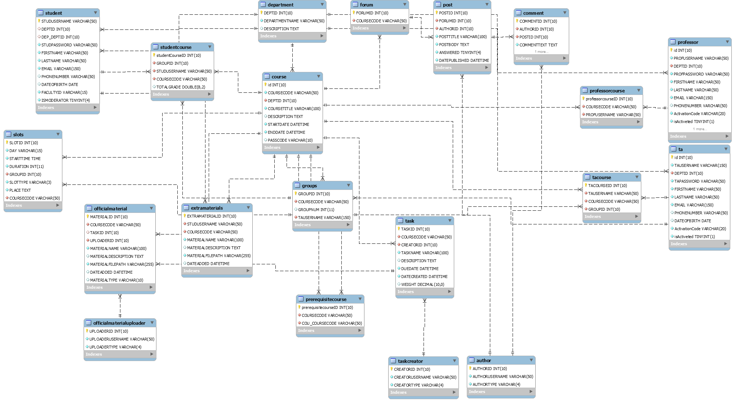
ERD

Slide 19
Tools
Frontend:
Android Studio IDE
Firebase
Backend:
Laravel
PHPStorm IDE

Slide 20
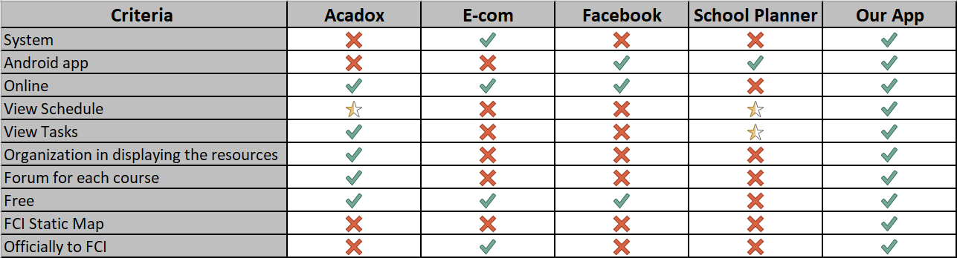
Related work

Slide 21
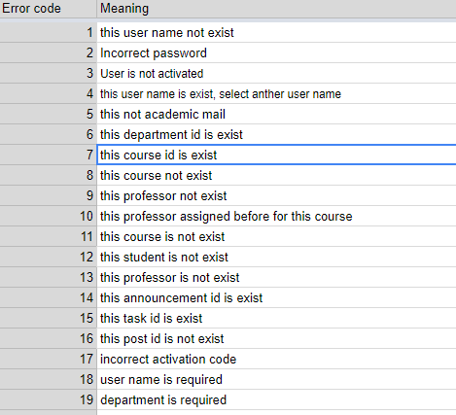
Services error codes
Some of the error codes used in the services to indicate error states

Slide 22
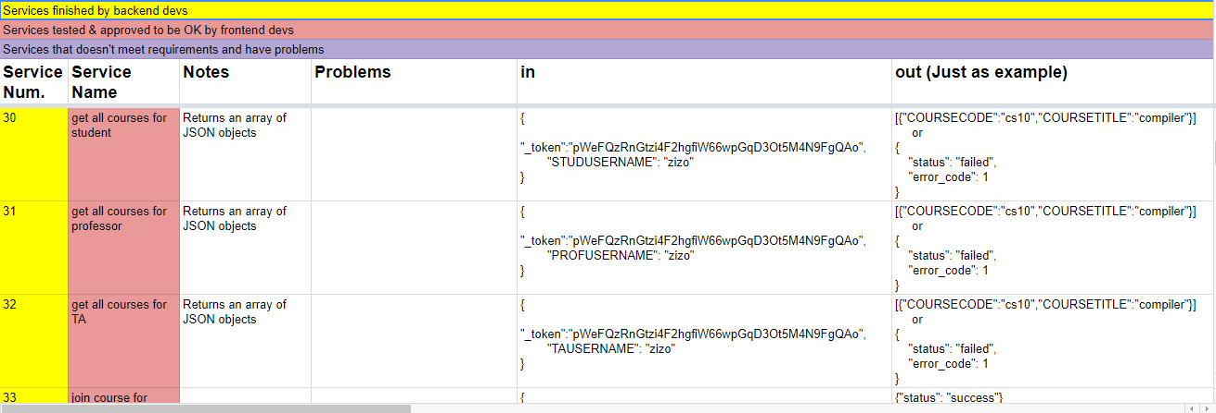
Services definition, request body and responses

Slide 23
Final Product (Android app)

Slide 24
As a Student

Slide 25
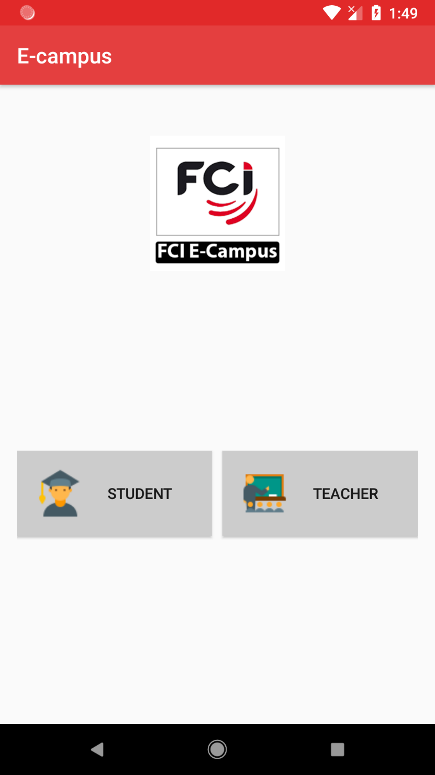

Welcome Screen
Are you Student or Teacher?

Slide 26
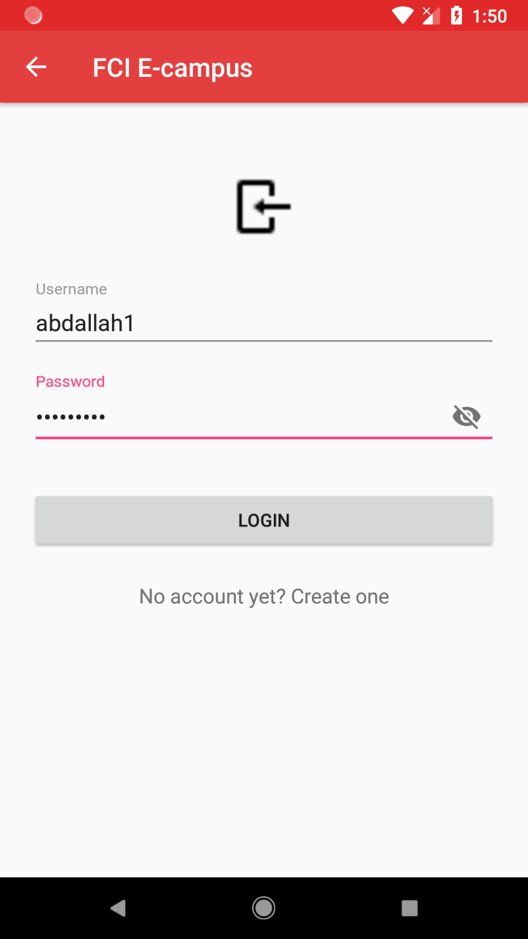
Student Login
Login with username & password

Slide 27
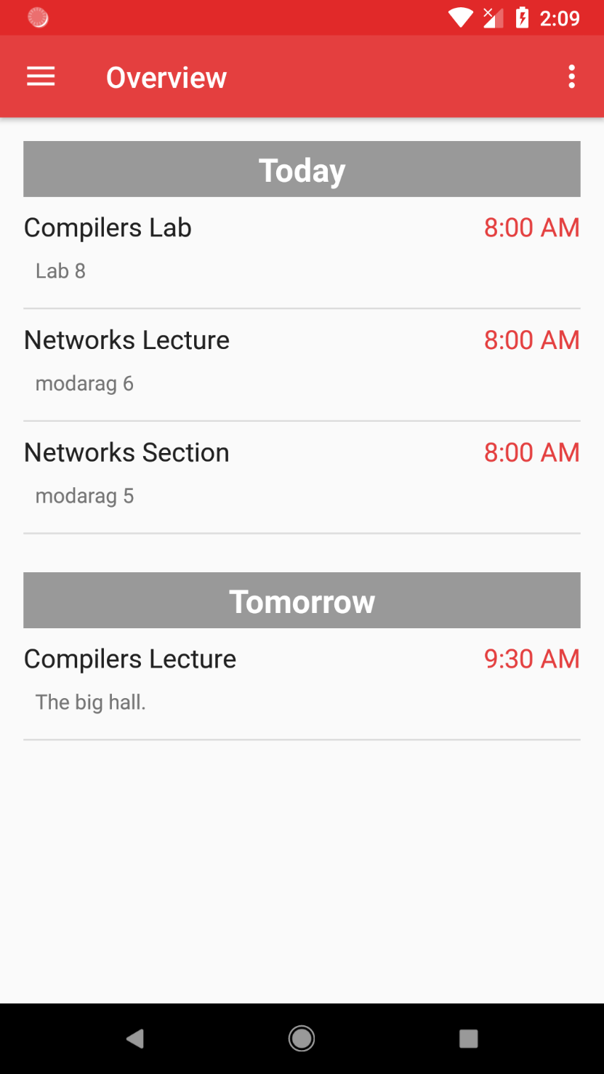
Quick Overview
Today
&
Tomorrow

Slide 28

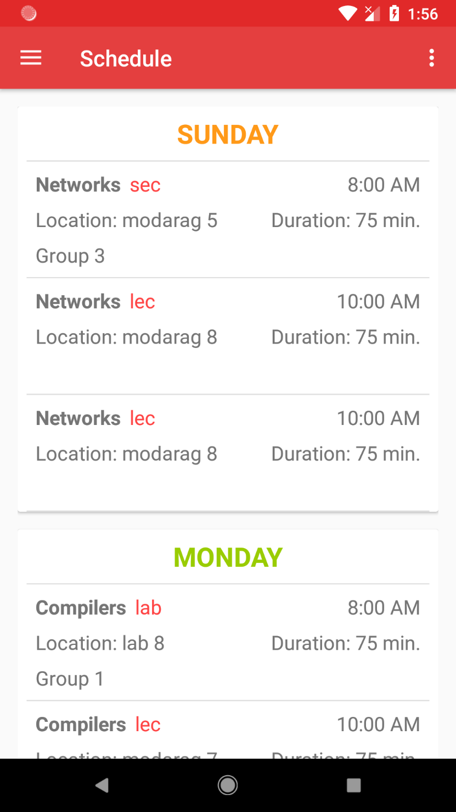
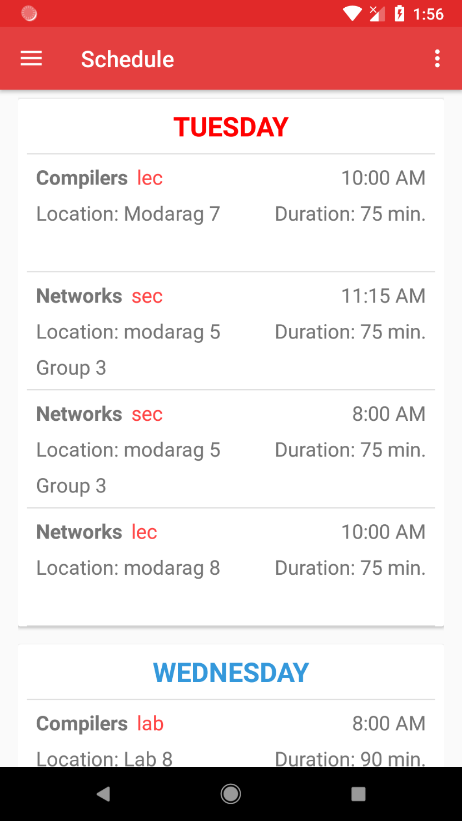
My Schedule
Daily schedule for every day of the week
Displays lectures. Labs & sections for only my group

Slide 29
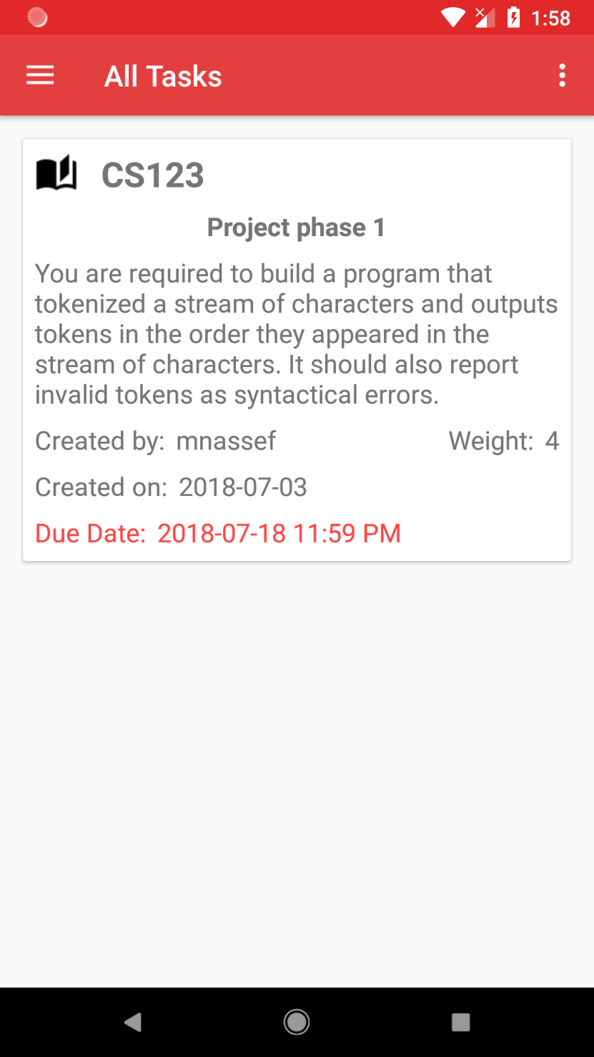
All Tasks
All the tasks from all my courses

Slide 30
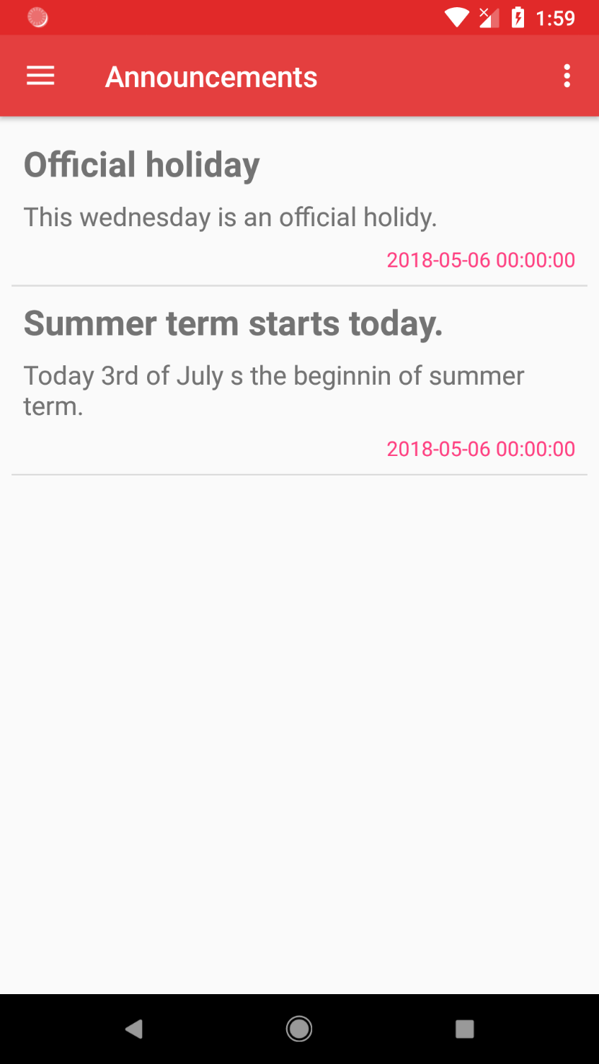
Announcements
Official announcements from faculty management

Slide 31
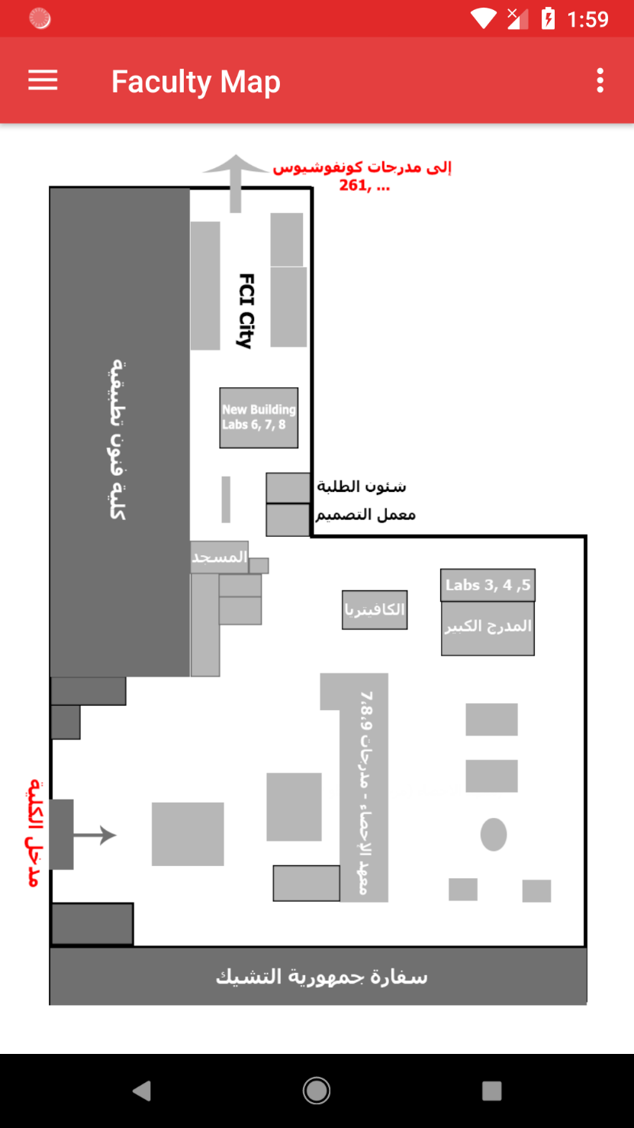
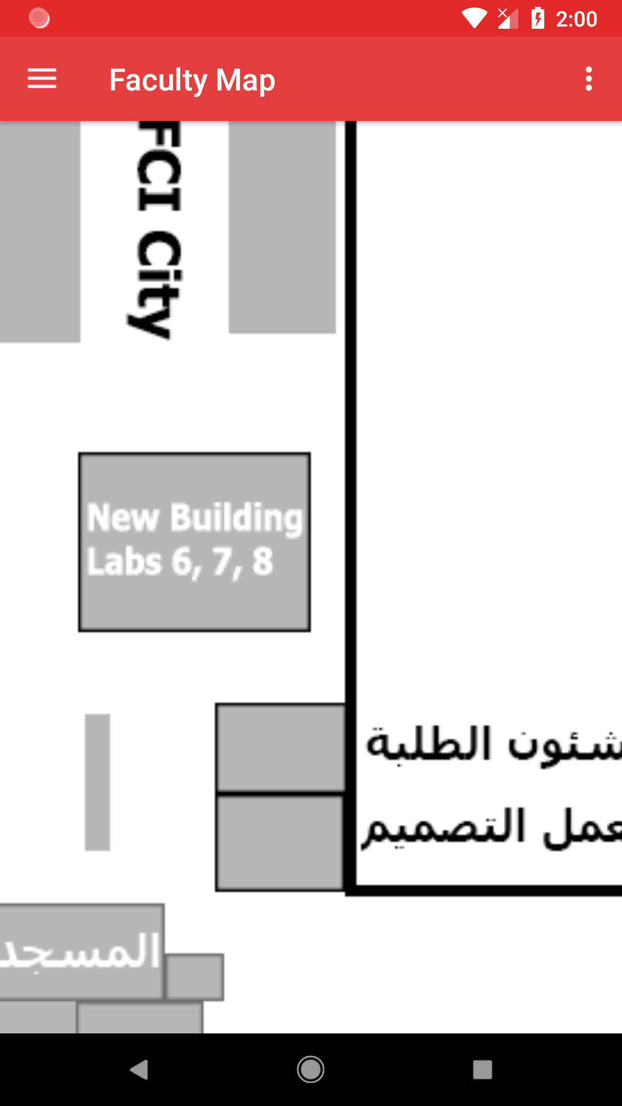
Faculty Map
Find important buildings and places
Zoom in & out

Slide 32
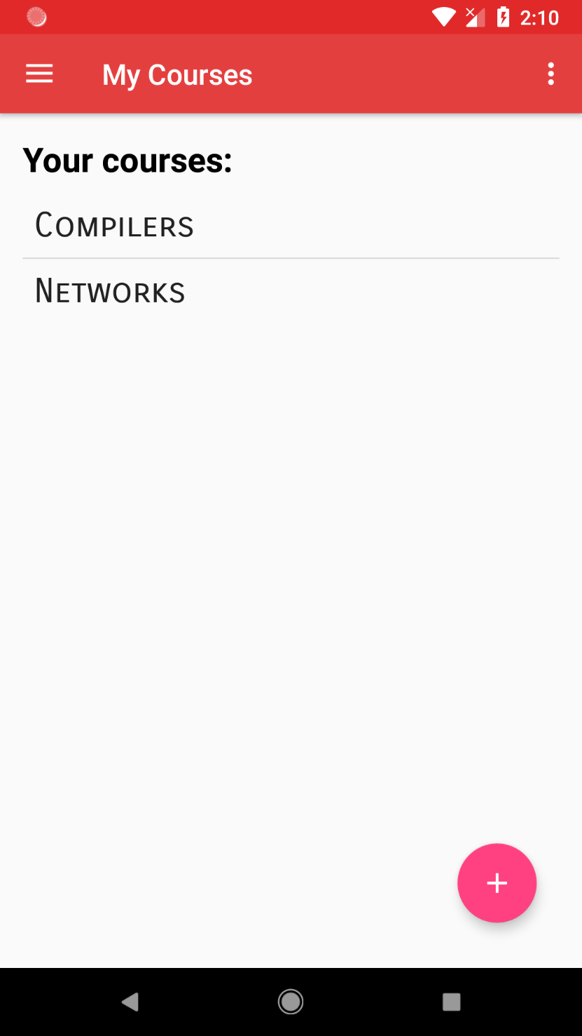
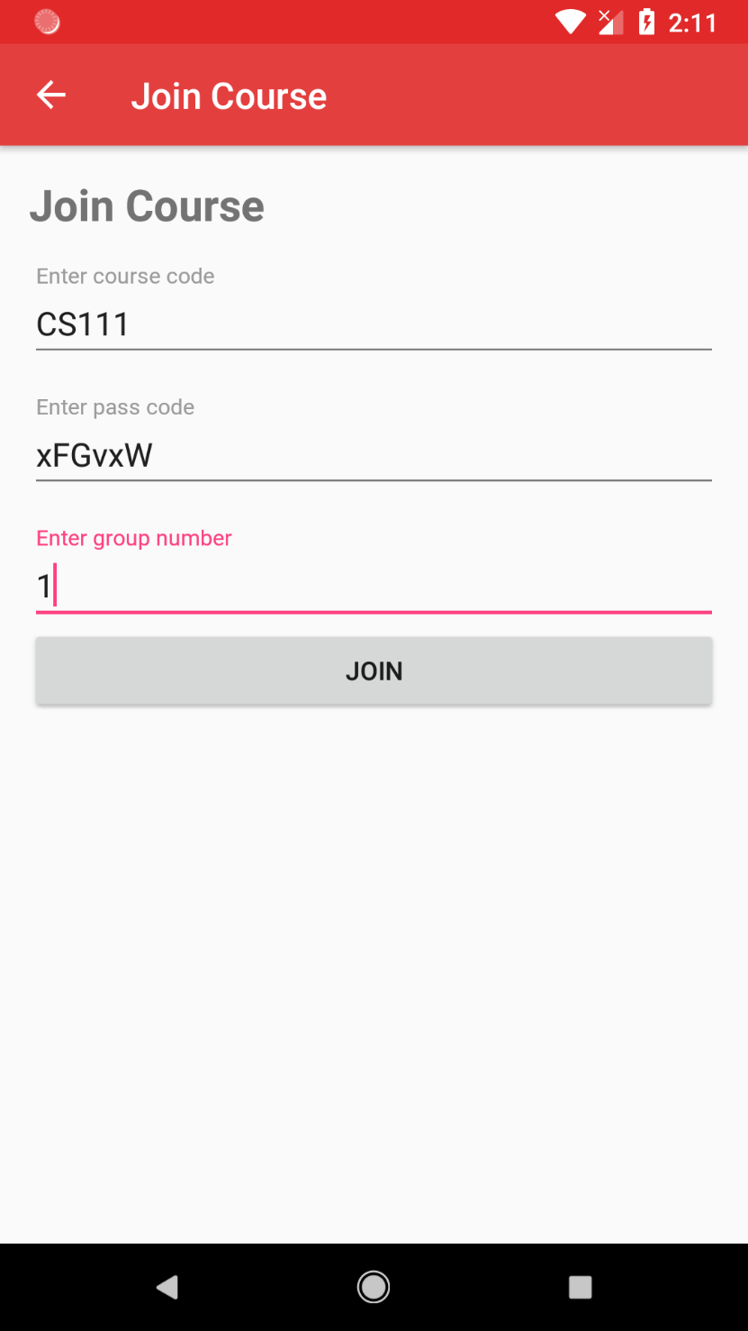
My Courses
Courses that I’ve already joined
Join a New Course
Join a course by its faculty course code

Slide 33
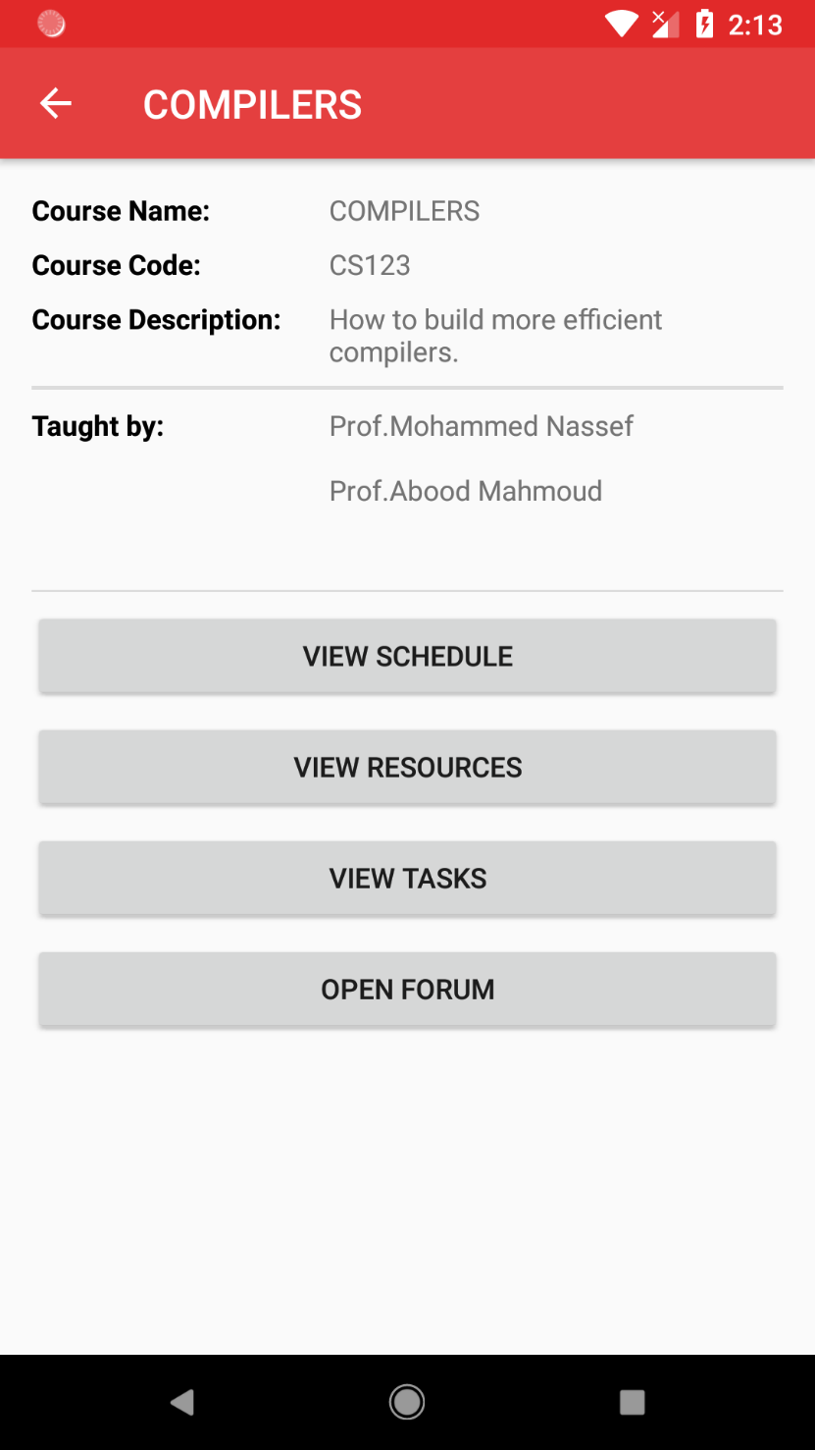
Course Screen
Show course’s info & actions

Slide 34
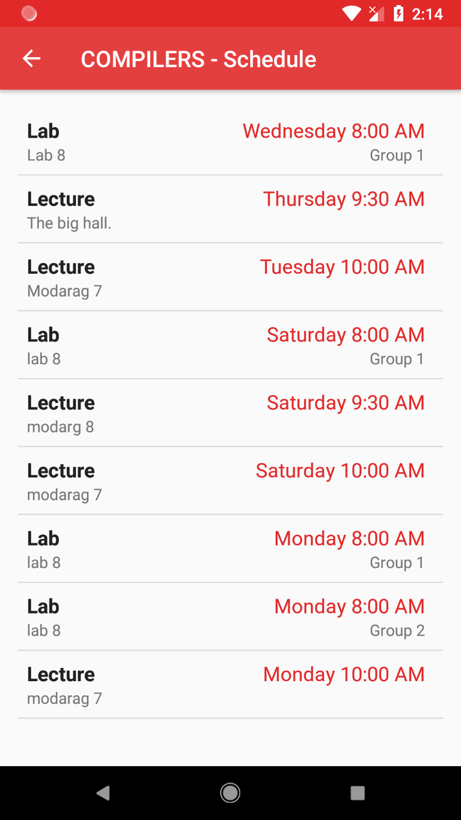
Course Schedule
All lectures, labs & sections that belong to this course

Slide 35
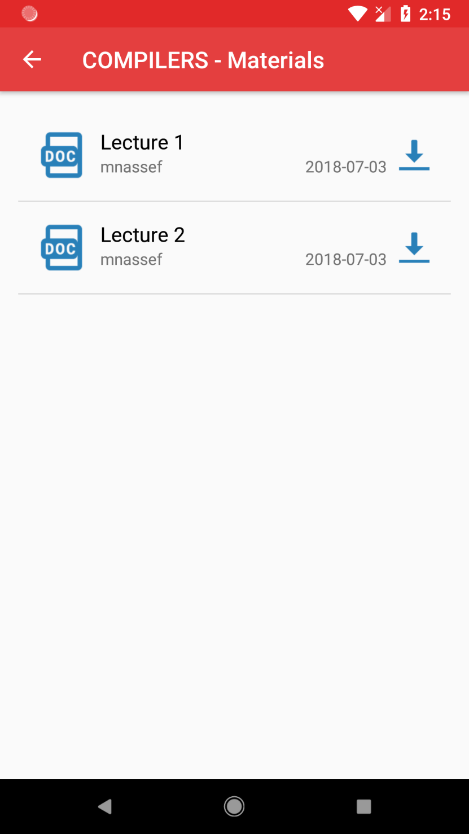
Course Materials
Choose a file to download

Slide 36
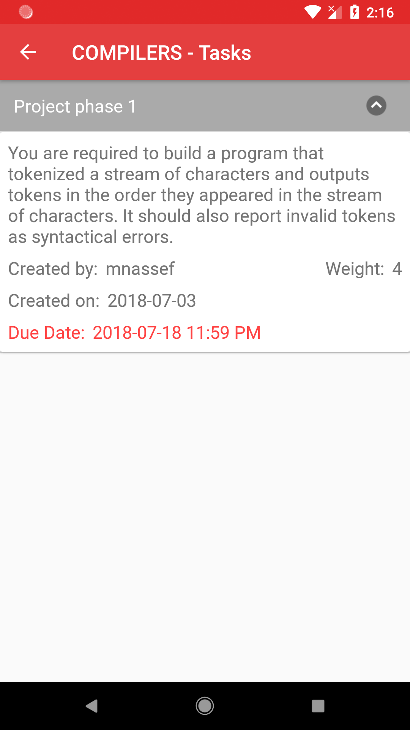
Course Tasks
Show tasks for this course only

Slide 37
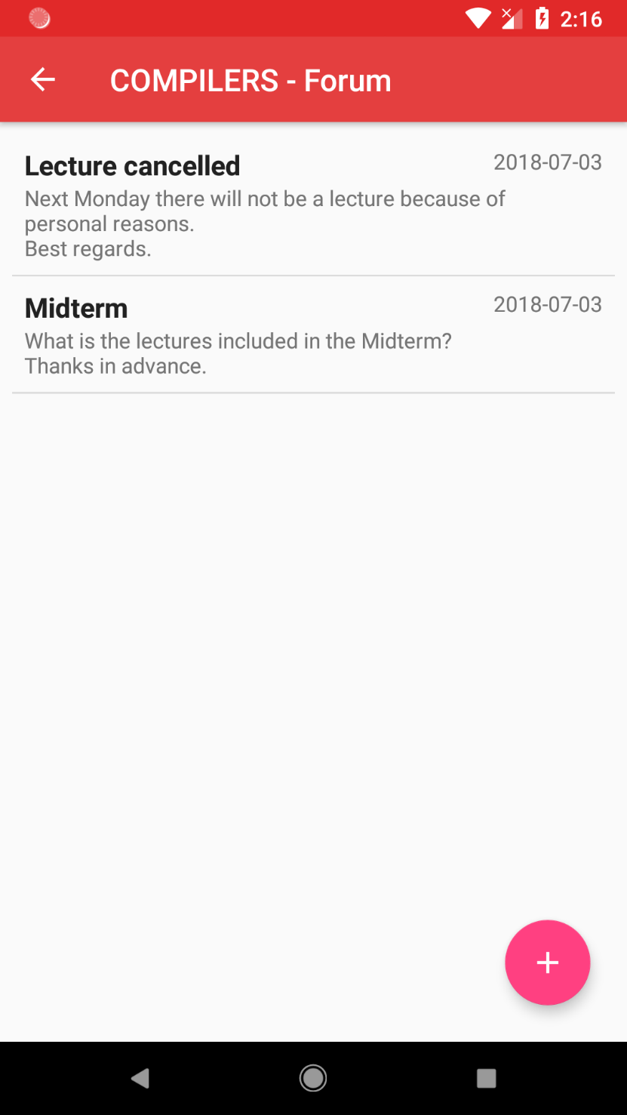
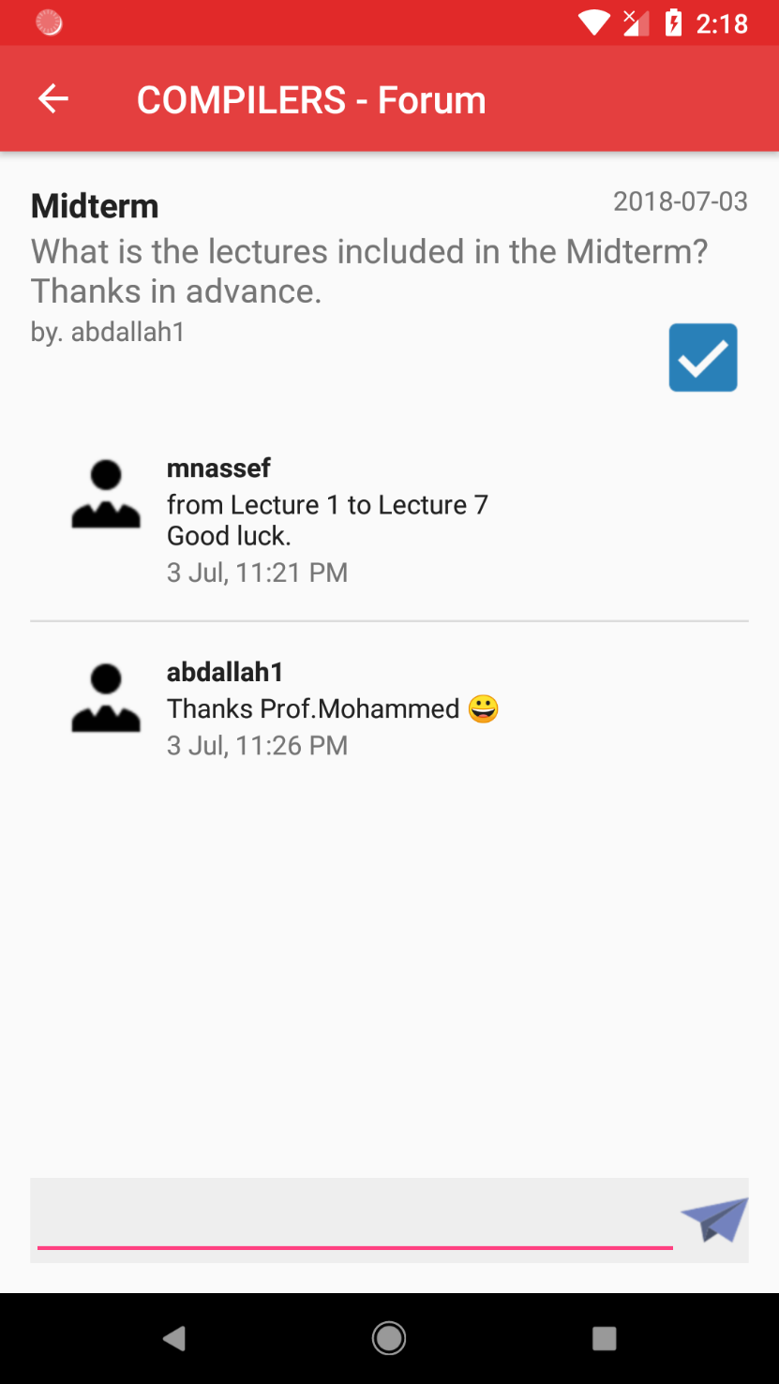
Course Forum
Ask and answer questions
Open Comments
Read and add comments on posts

Slide 38
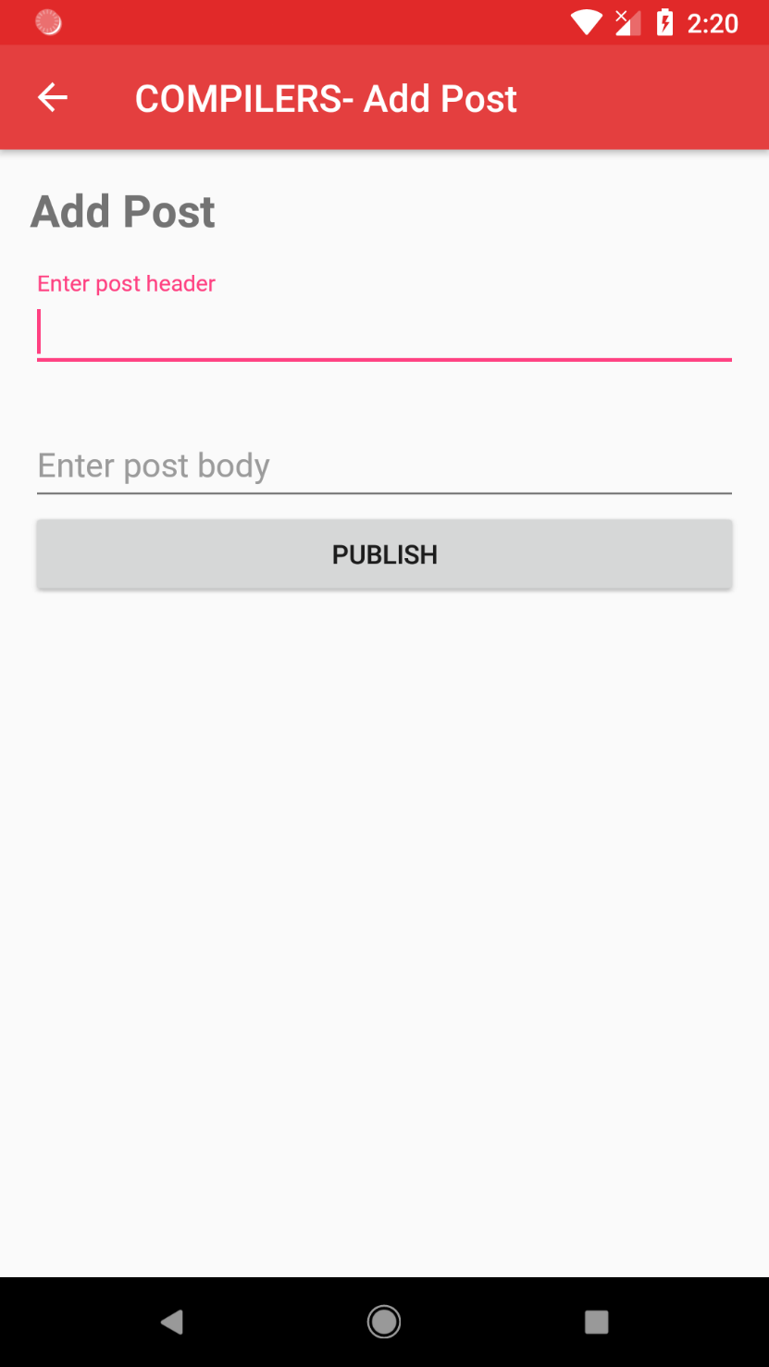
Course Forum
Ask and answer questions
Make a Post
Ask your colleagues, professor & TAs

Slide 39
As Professor or TA

Slide 40
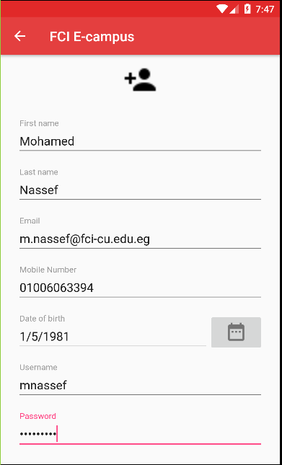
Teacher Signup
Key is generated
And sent to
the academic mail

Slide 41
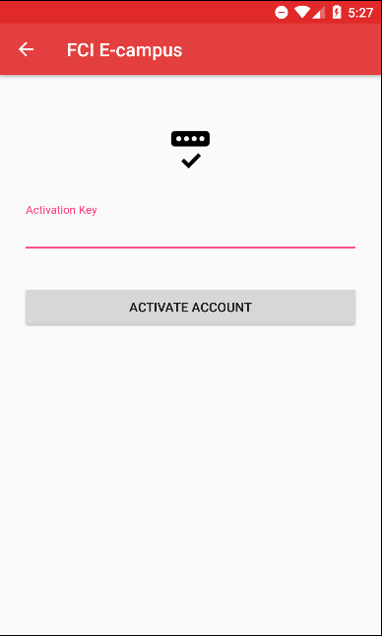

Activation
Keys is being Sent to
Academic mail

Slide 42
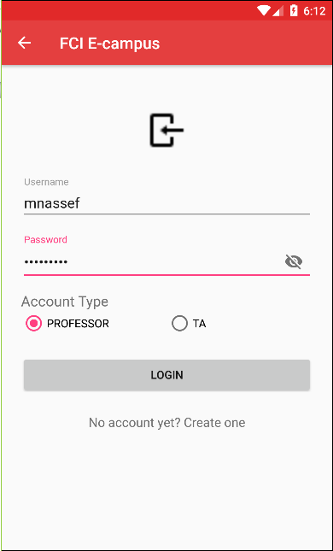

Teacher Login
Choose the type

Slide 43
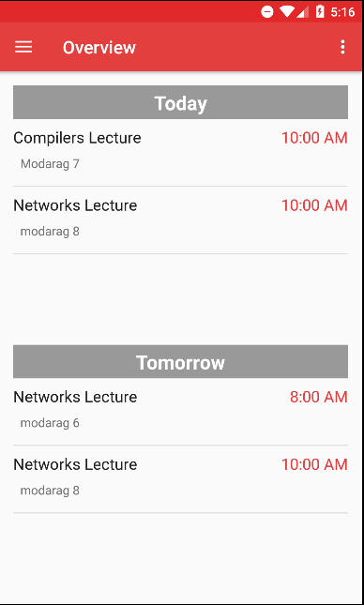
Prof Overview
Shows only
Lectures

Slide 44
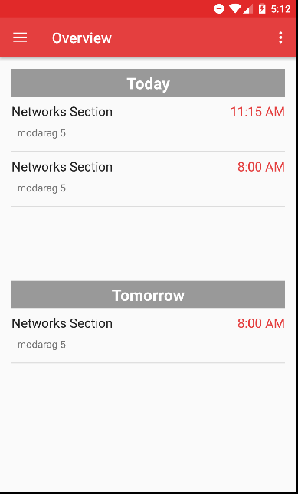
TA Overview
Shows only
Sections and Labs

Slide 45
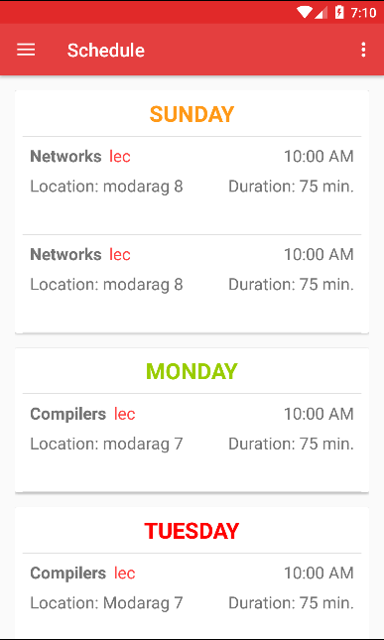
Professor Schedule
Week days’ Lectures

Slide 46
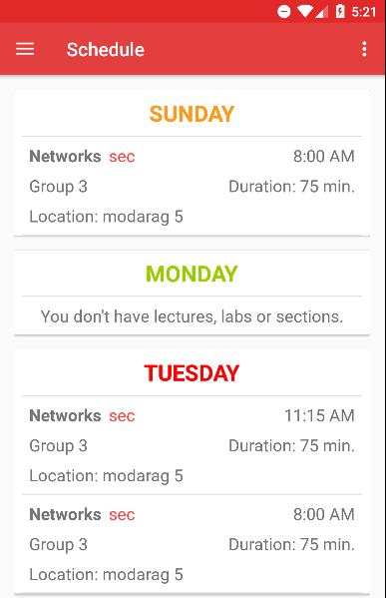
TA Schedule
Week days’ Sections
And Labs

Slide 47
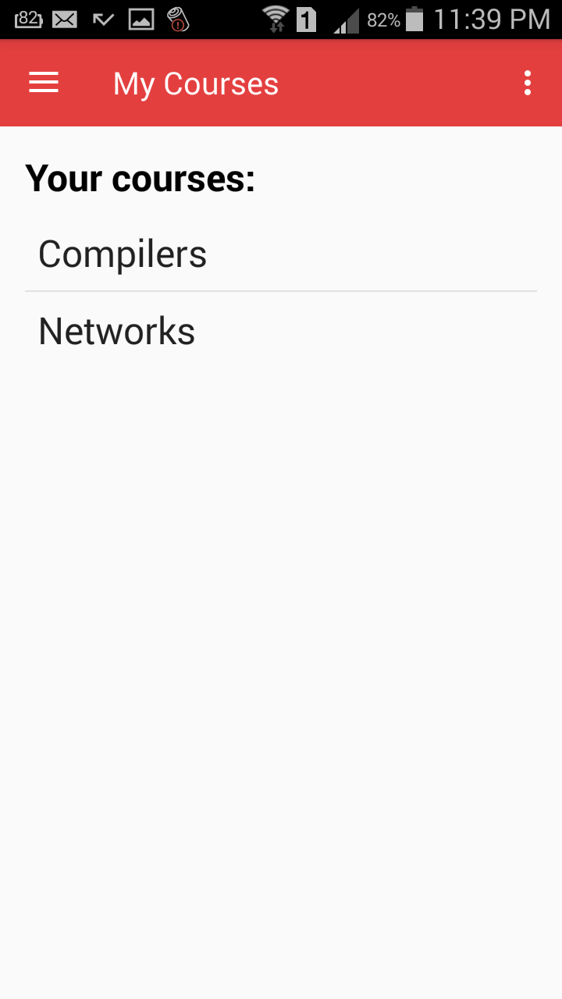
My courses
Get all registered
courses

Slide 48
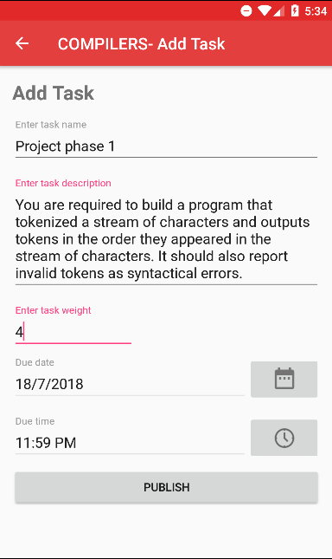

Add Task
Profs and TAs can add
tasks on their courses

Slide 49
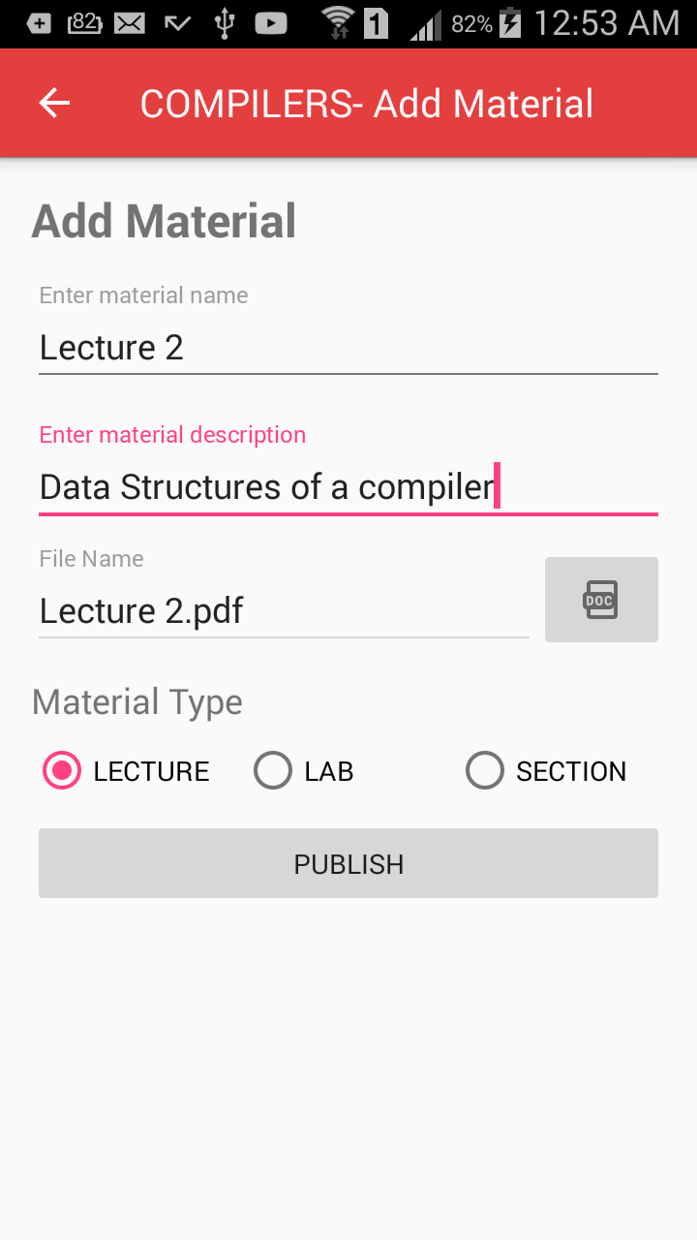

Add Material
Profs and TAs can add
materials on their courses

Slide 50
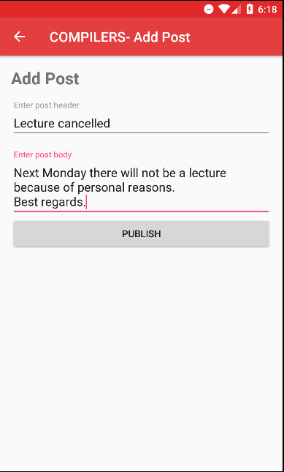
Course Forum
Teacher can publish
announcement throw
course forum

Slide 51
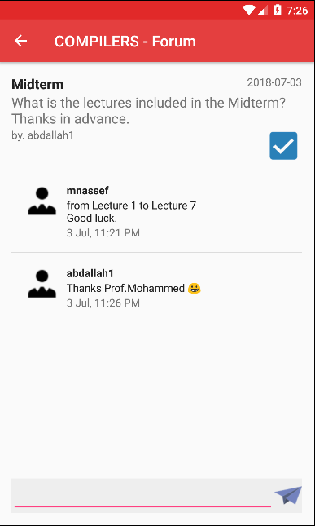
Prof Add Comment
Professor can react
with course’s forum’s
posts with adding
comments

Slide 52
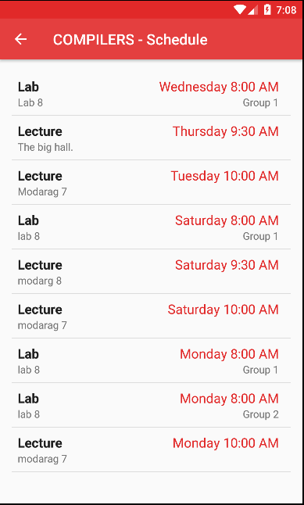
Course Schedule
Get all slots of the
course

Slide 53
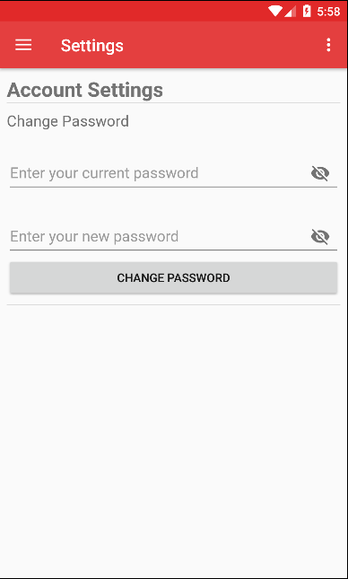
Settings
User can change
his password

Slide 54
Final Product (Admin Website)

Slide 55
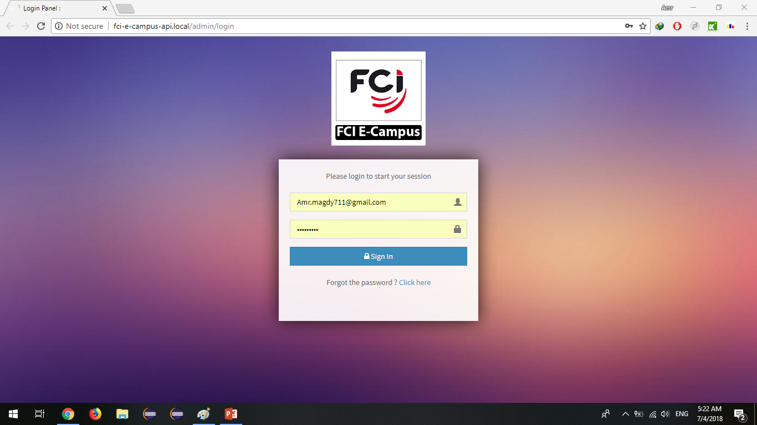
Admin Login
Enter email & password

Slide 56
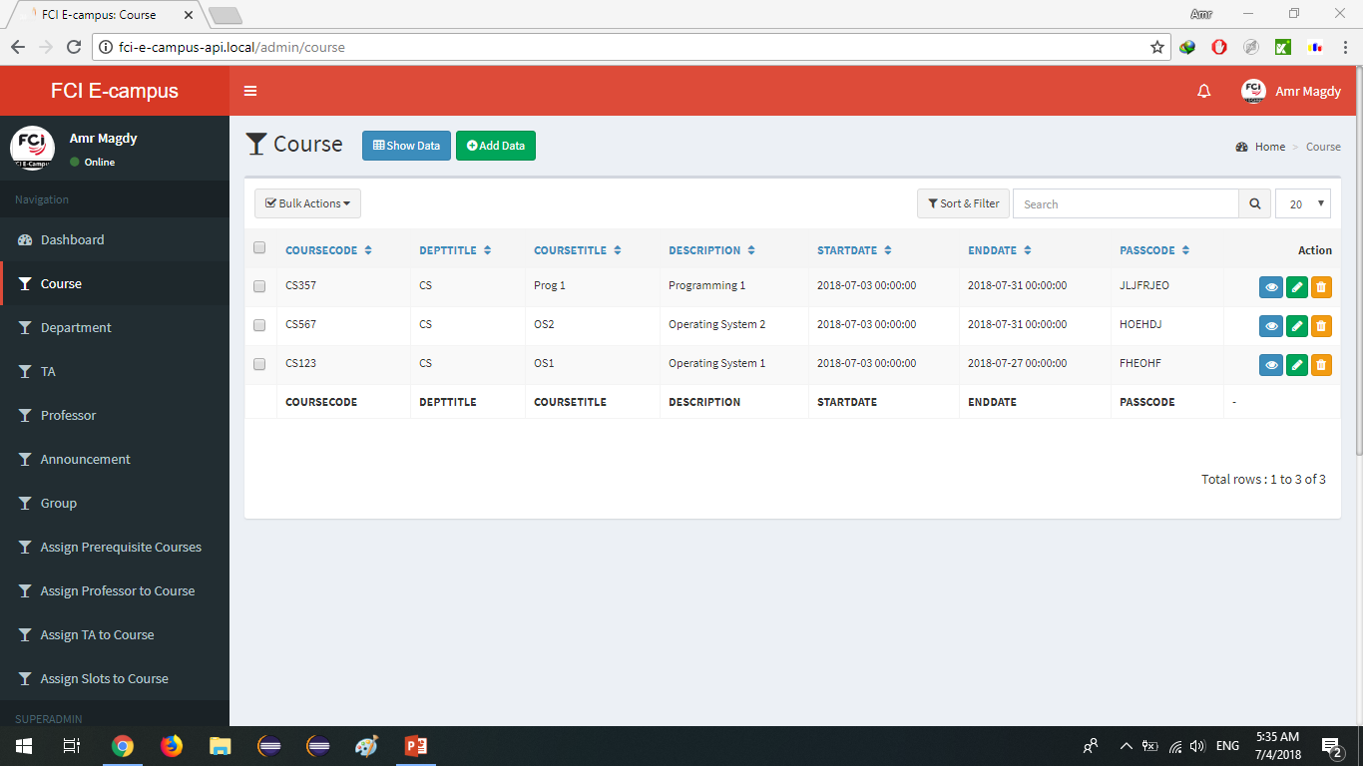
Show Courses
Get all the courses in the DB

Slide 57
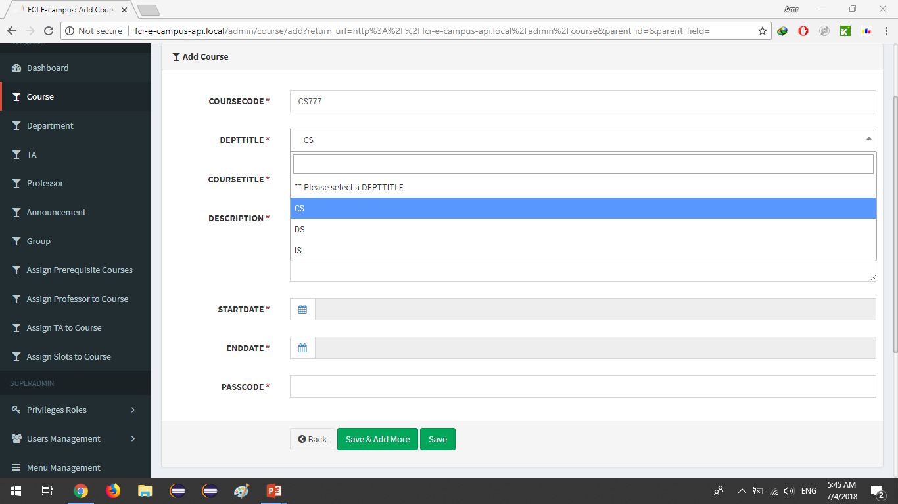
Add Courses
Enter information and save the course in the DB

Slide 58
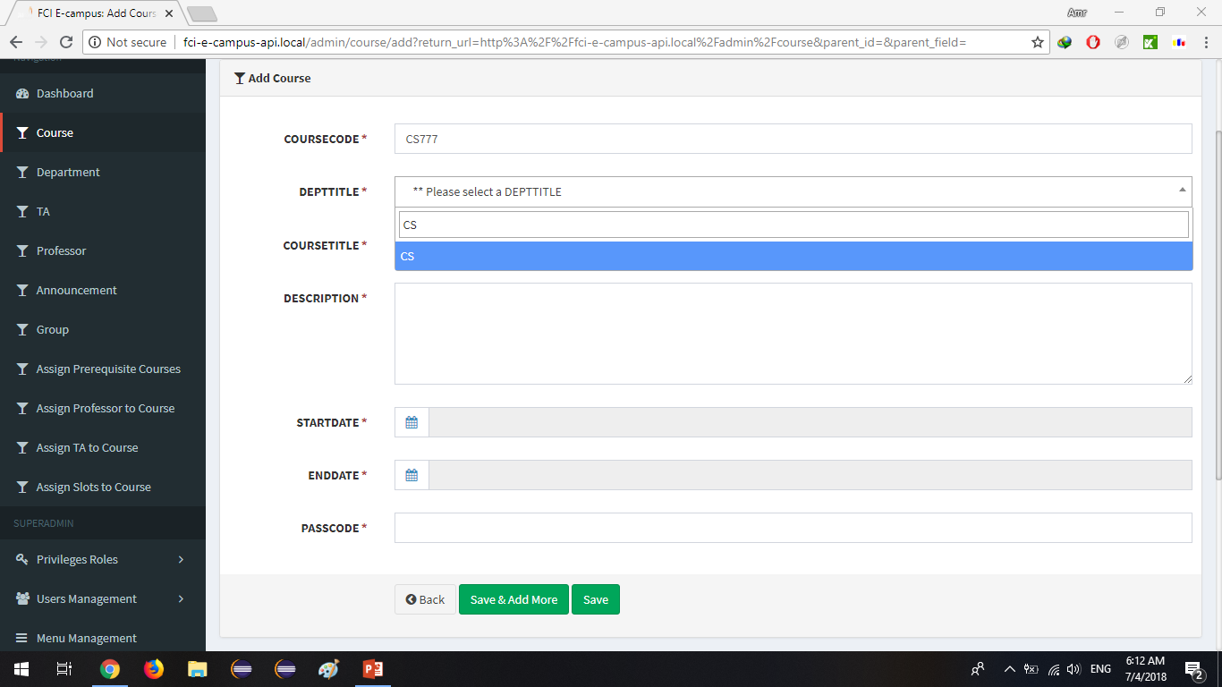
Add Courses
Search box

Slide 59
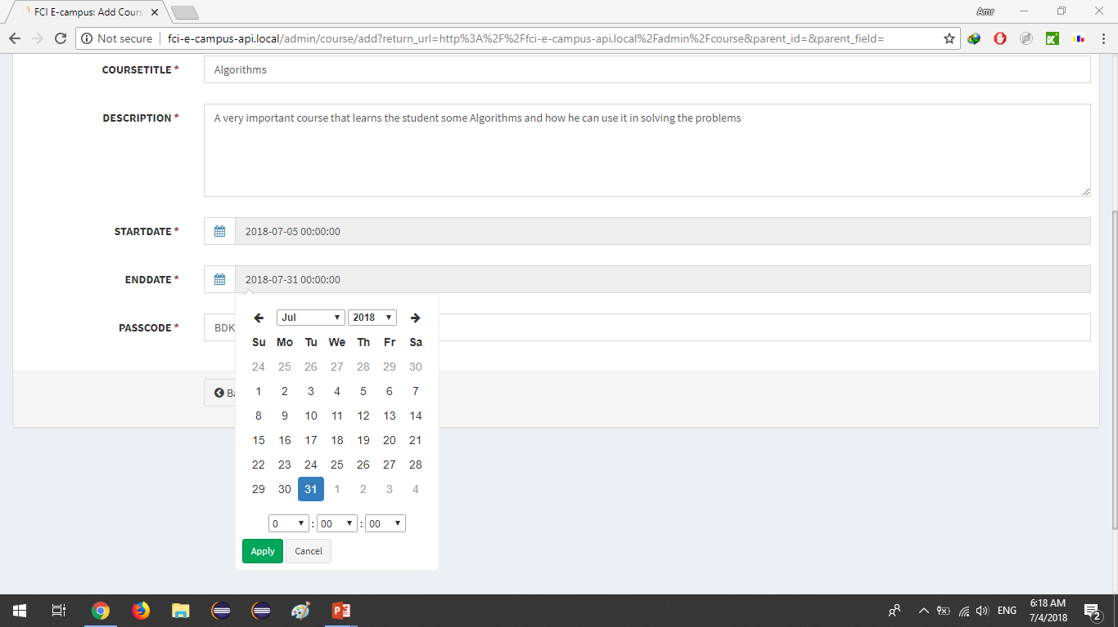
Add Courses
Date box

Slide 60

Add Courses
Information added Click save

Slide 61

Add Courses
Course added successfully

Slide 62

Logout
Select shutdown button

Slide 63

Logout
Select Logout

Slide 64

Logout
Successfully Logout

Slide 65

Privileges
Another admin with another privileges

Slide 66
Conclusion

Slide 67
Any questions?

